Slide 1
Production data presentation
Perekebina ANGALABIRI
&
Anatole GOBETTI

Slide 2
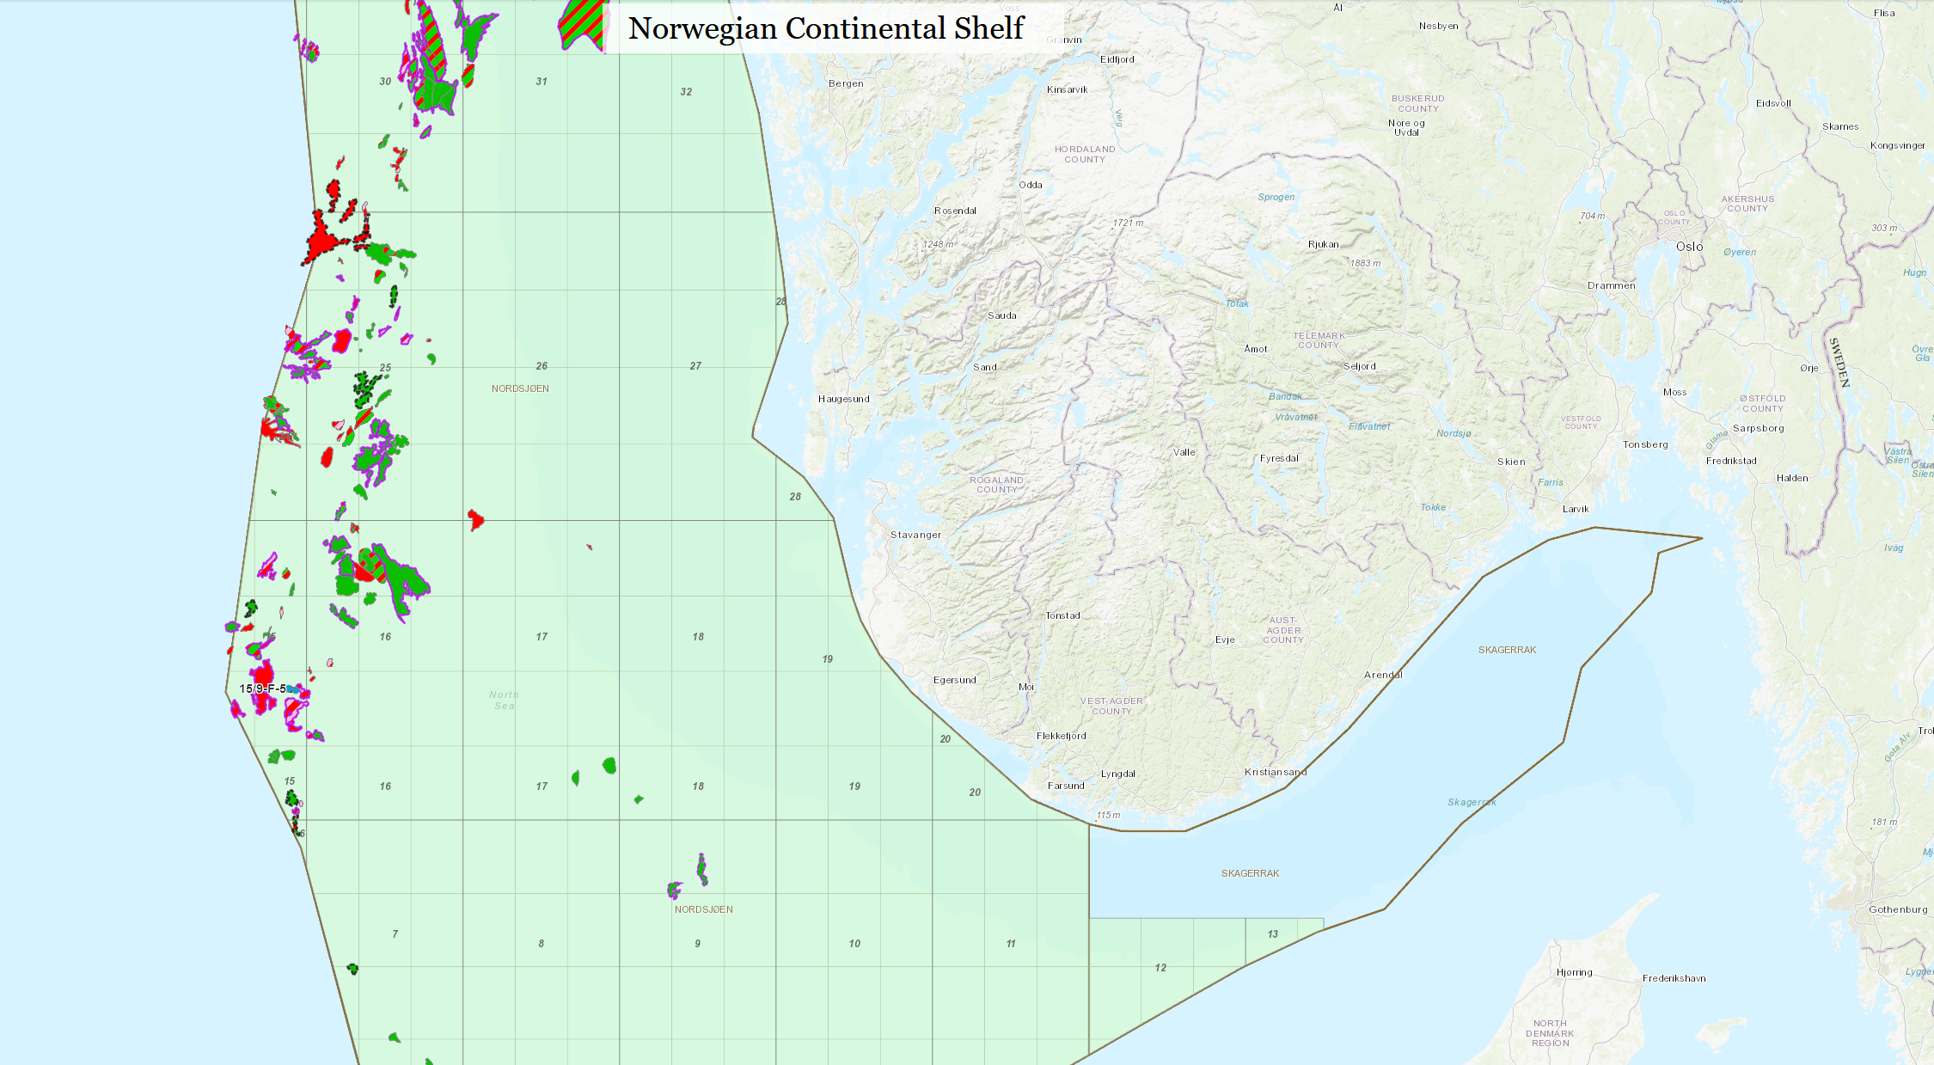
Volve field: maps
Volve
50 Km

Slide 3
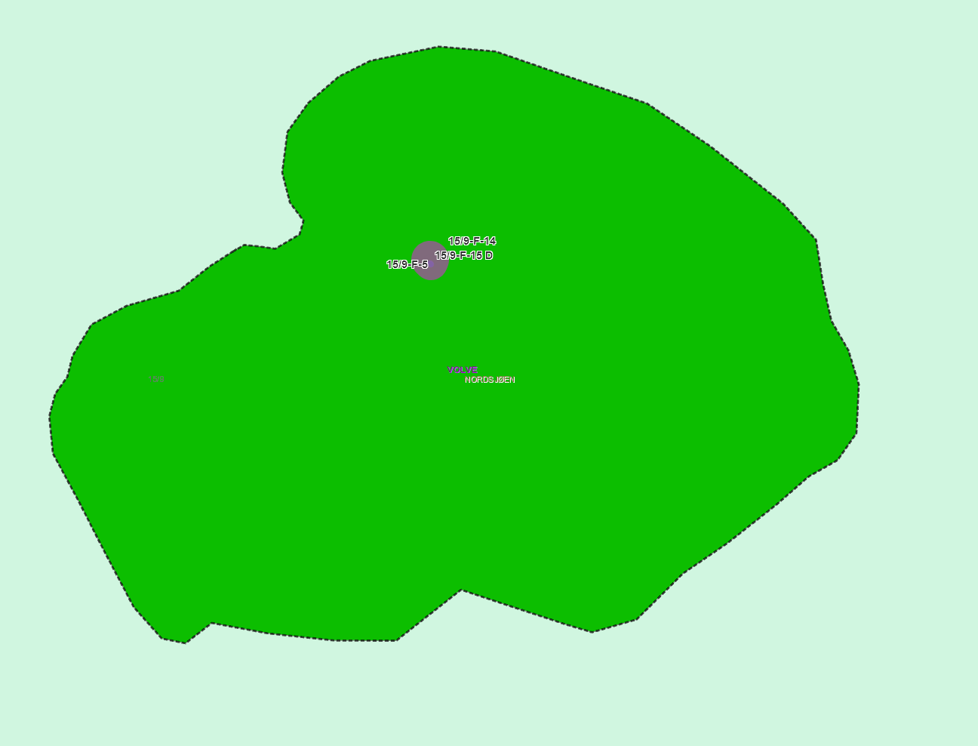
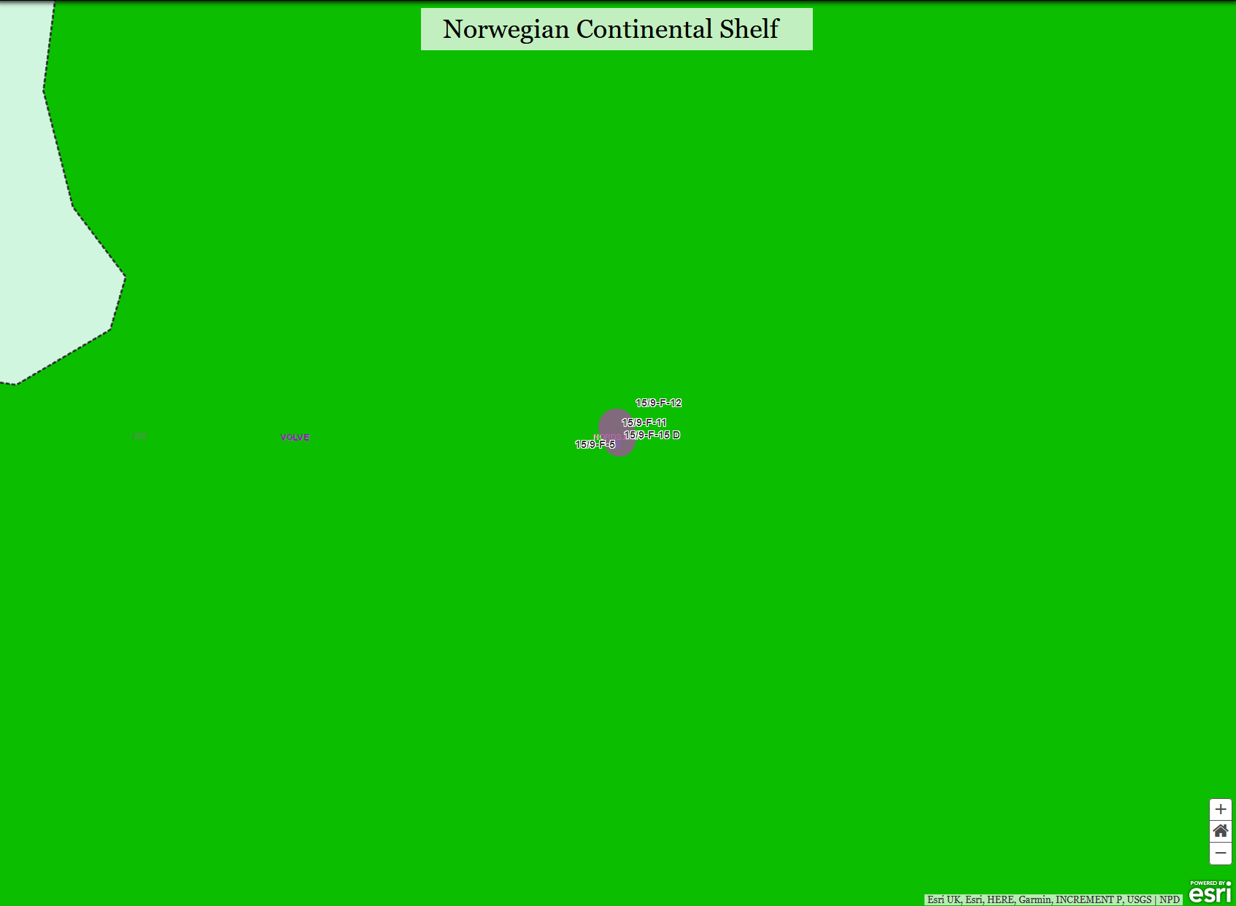
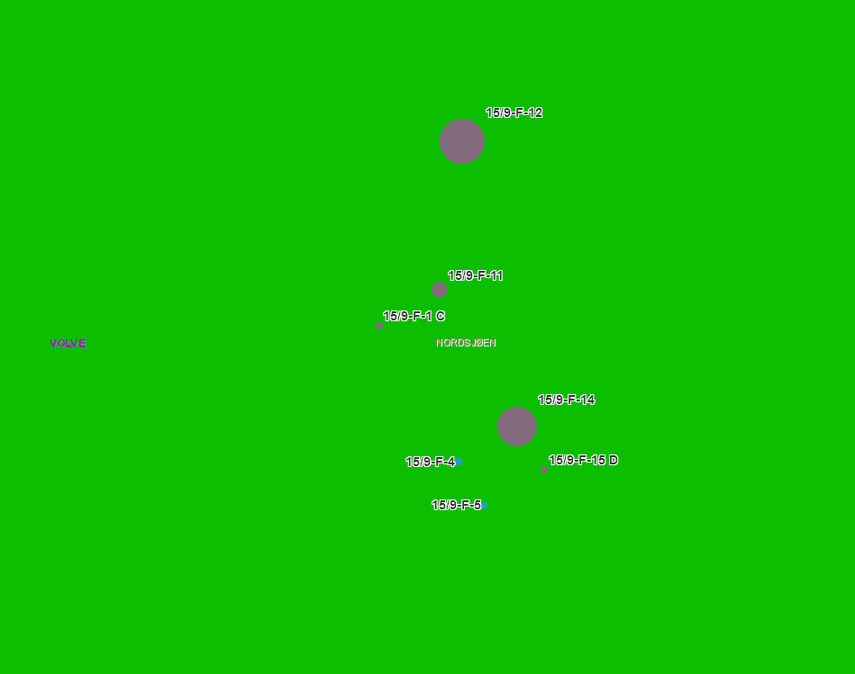
Volve field: maps
2 Km
Wells are closely bunched together
Biggest producers are the F12 and F14 wells
F-11, F-1C and F-15D are smaller producers
F-4 and F-5 are injection wells

Slide 4
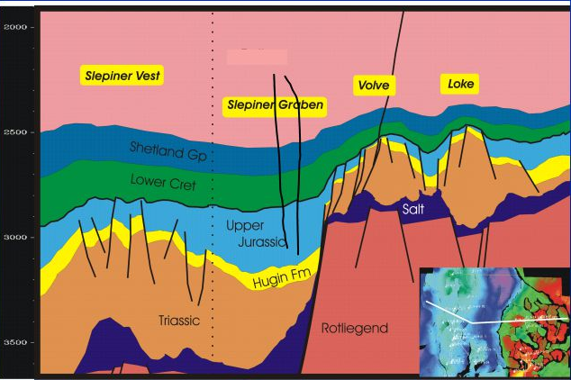
Volve field: Exploratory phase
Structure:
Volve field: 2*3 km
Dome-shaped structure formed by the collapse of adjacent salt ridges (turtle back structure?) during the middle Jurassic. It is heavily faulted as a result of this formation process and of the initial extension.
The reservoir is thus thicker on the flanks (100m) than on the crest (20m)
Reservoir
Hugin formation (Jura-Trias) is a clean, shallow-water tidal sandstone, laterally expansive.
Average reservoir depth : 2750 - 3120 tvdss.
PHI = 21% ; K = 1 Darcy; NTG = 93%; Sw = 20% in oil zone
Oil-Water contact was estimated to be approximately 3120 m below sea level, but was never found.
Fluids
Studies of fluid indicated that the oil in the Volve field was formed in the Sleipner Graben area, in the NW part of the field, 10 million years ago and later on migrated into the Volve reservoir structure.

Slide 5
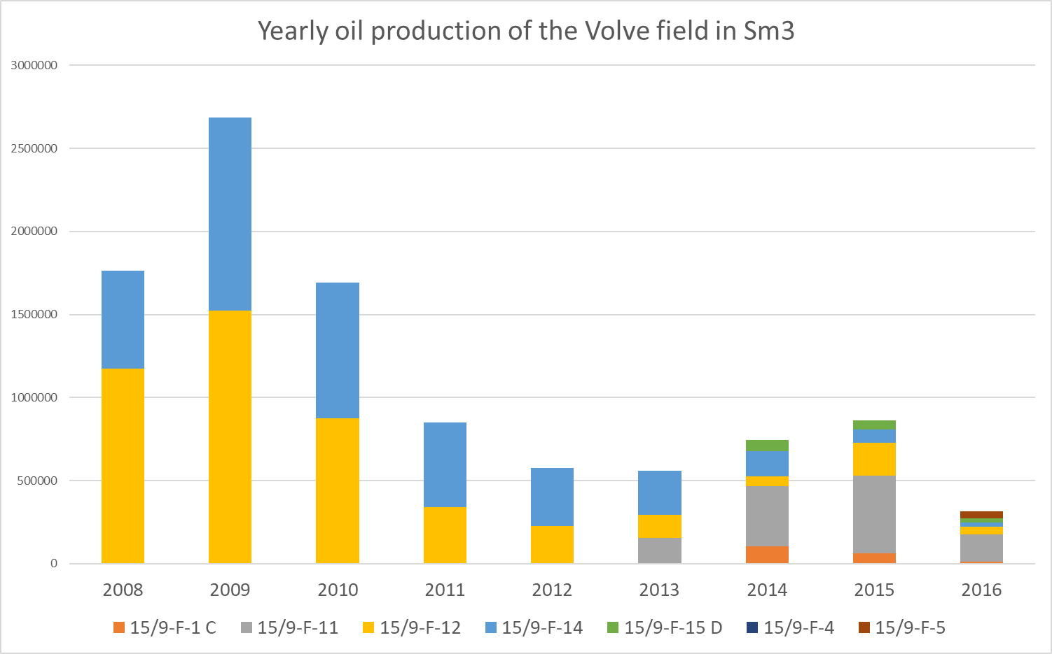
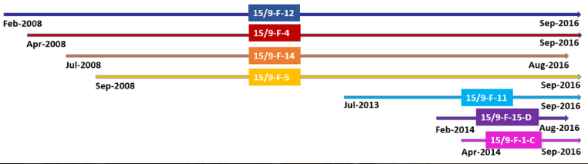
Volve field: Exploratory phase
The initial oil production rate (Exploration well 15/9-19SR) was observed to be 1358 sm3/d with a productivity index of 143 sm3/d/Bar, which allowed to identify a potential prolific reservoir.
Three main challenges were faced during the production face of Volve field:
1. Formation water with a high content of Barium.
2. Heavy oil features with a significant tendency to develop asphaltenes.
3. Water production from underlying Utsira formation.
At plateau, Volve produced approximately 8,900 Sm3 per day. It delivered a total of 10 million Sm3 of oil.
Timeline of operation of the wells of the Volve field (From arcgis website)

Slide 6
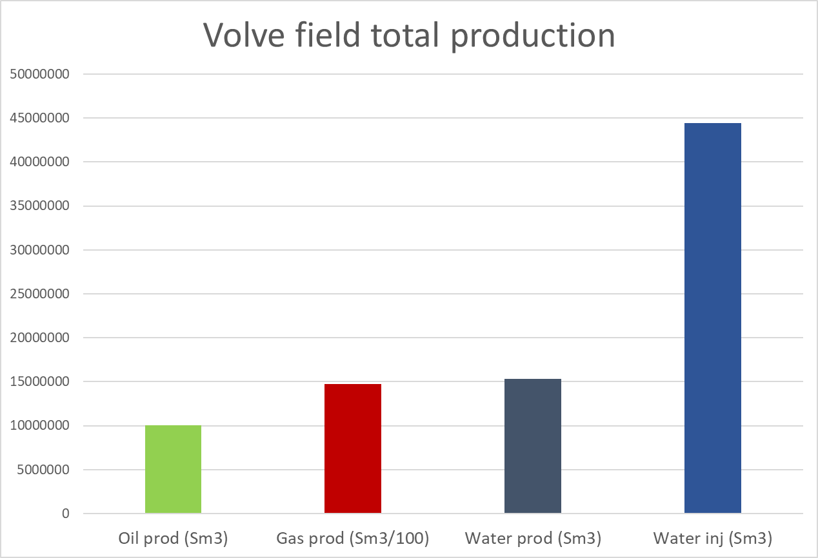
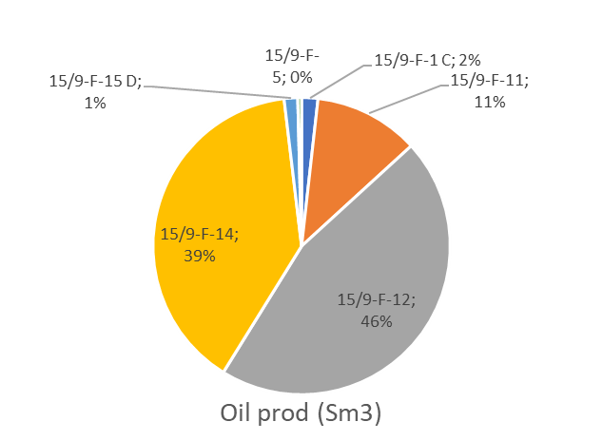
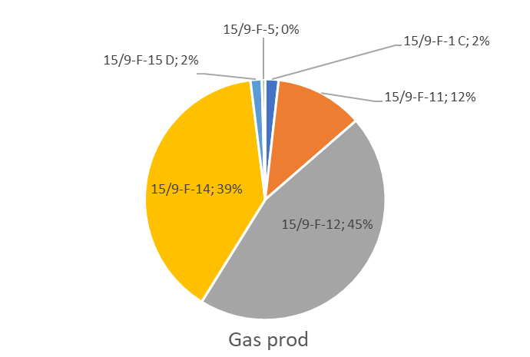
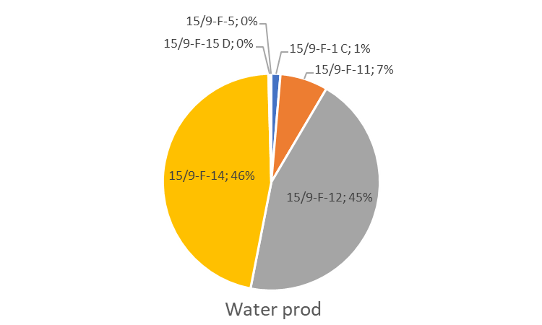
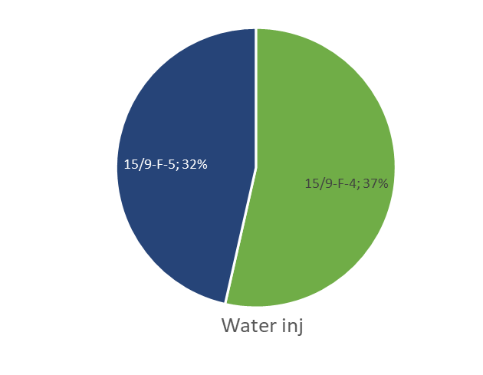
Volve field: Field Production
The oil production actually started in February 2008, after the first producer well, 15/9-F-12 was drilled, and lasted until September 2016. Subsequently, three injector and five oil producer wells were drilled. The following part focuses on the seven wells concerned by the data that was available.
In total, more than 10 million Sm3 of oil and nearly 1.5 billion Sm3 of gas were produced from the field. The water produced was reinjected as planned.
In 2013 due to a decrease in the production below the economical limit of 2,100 Sm3/d, three additional producer wells had to be drilled, 15/9-F-11, 15/9-F-15-D, 15/9-F-1-C. This increased the life of the field until 2016.

Slide 7
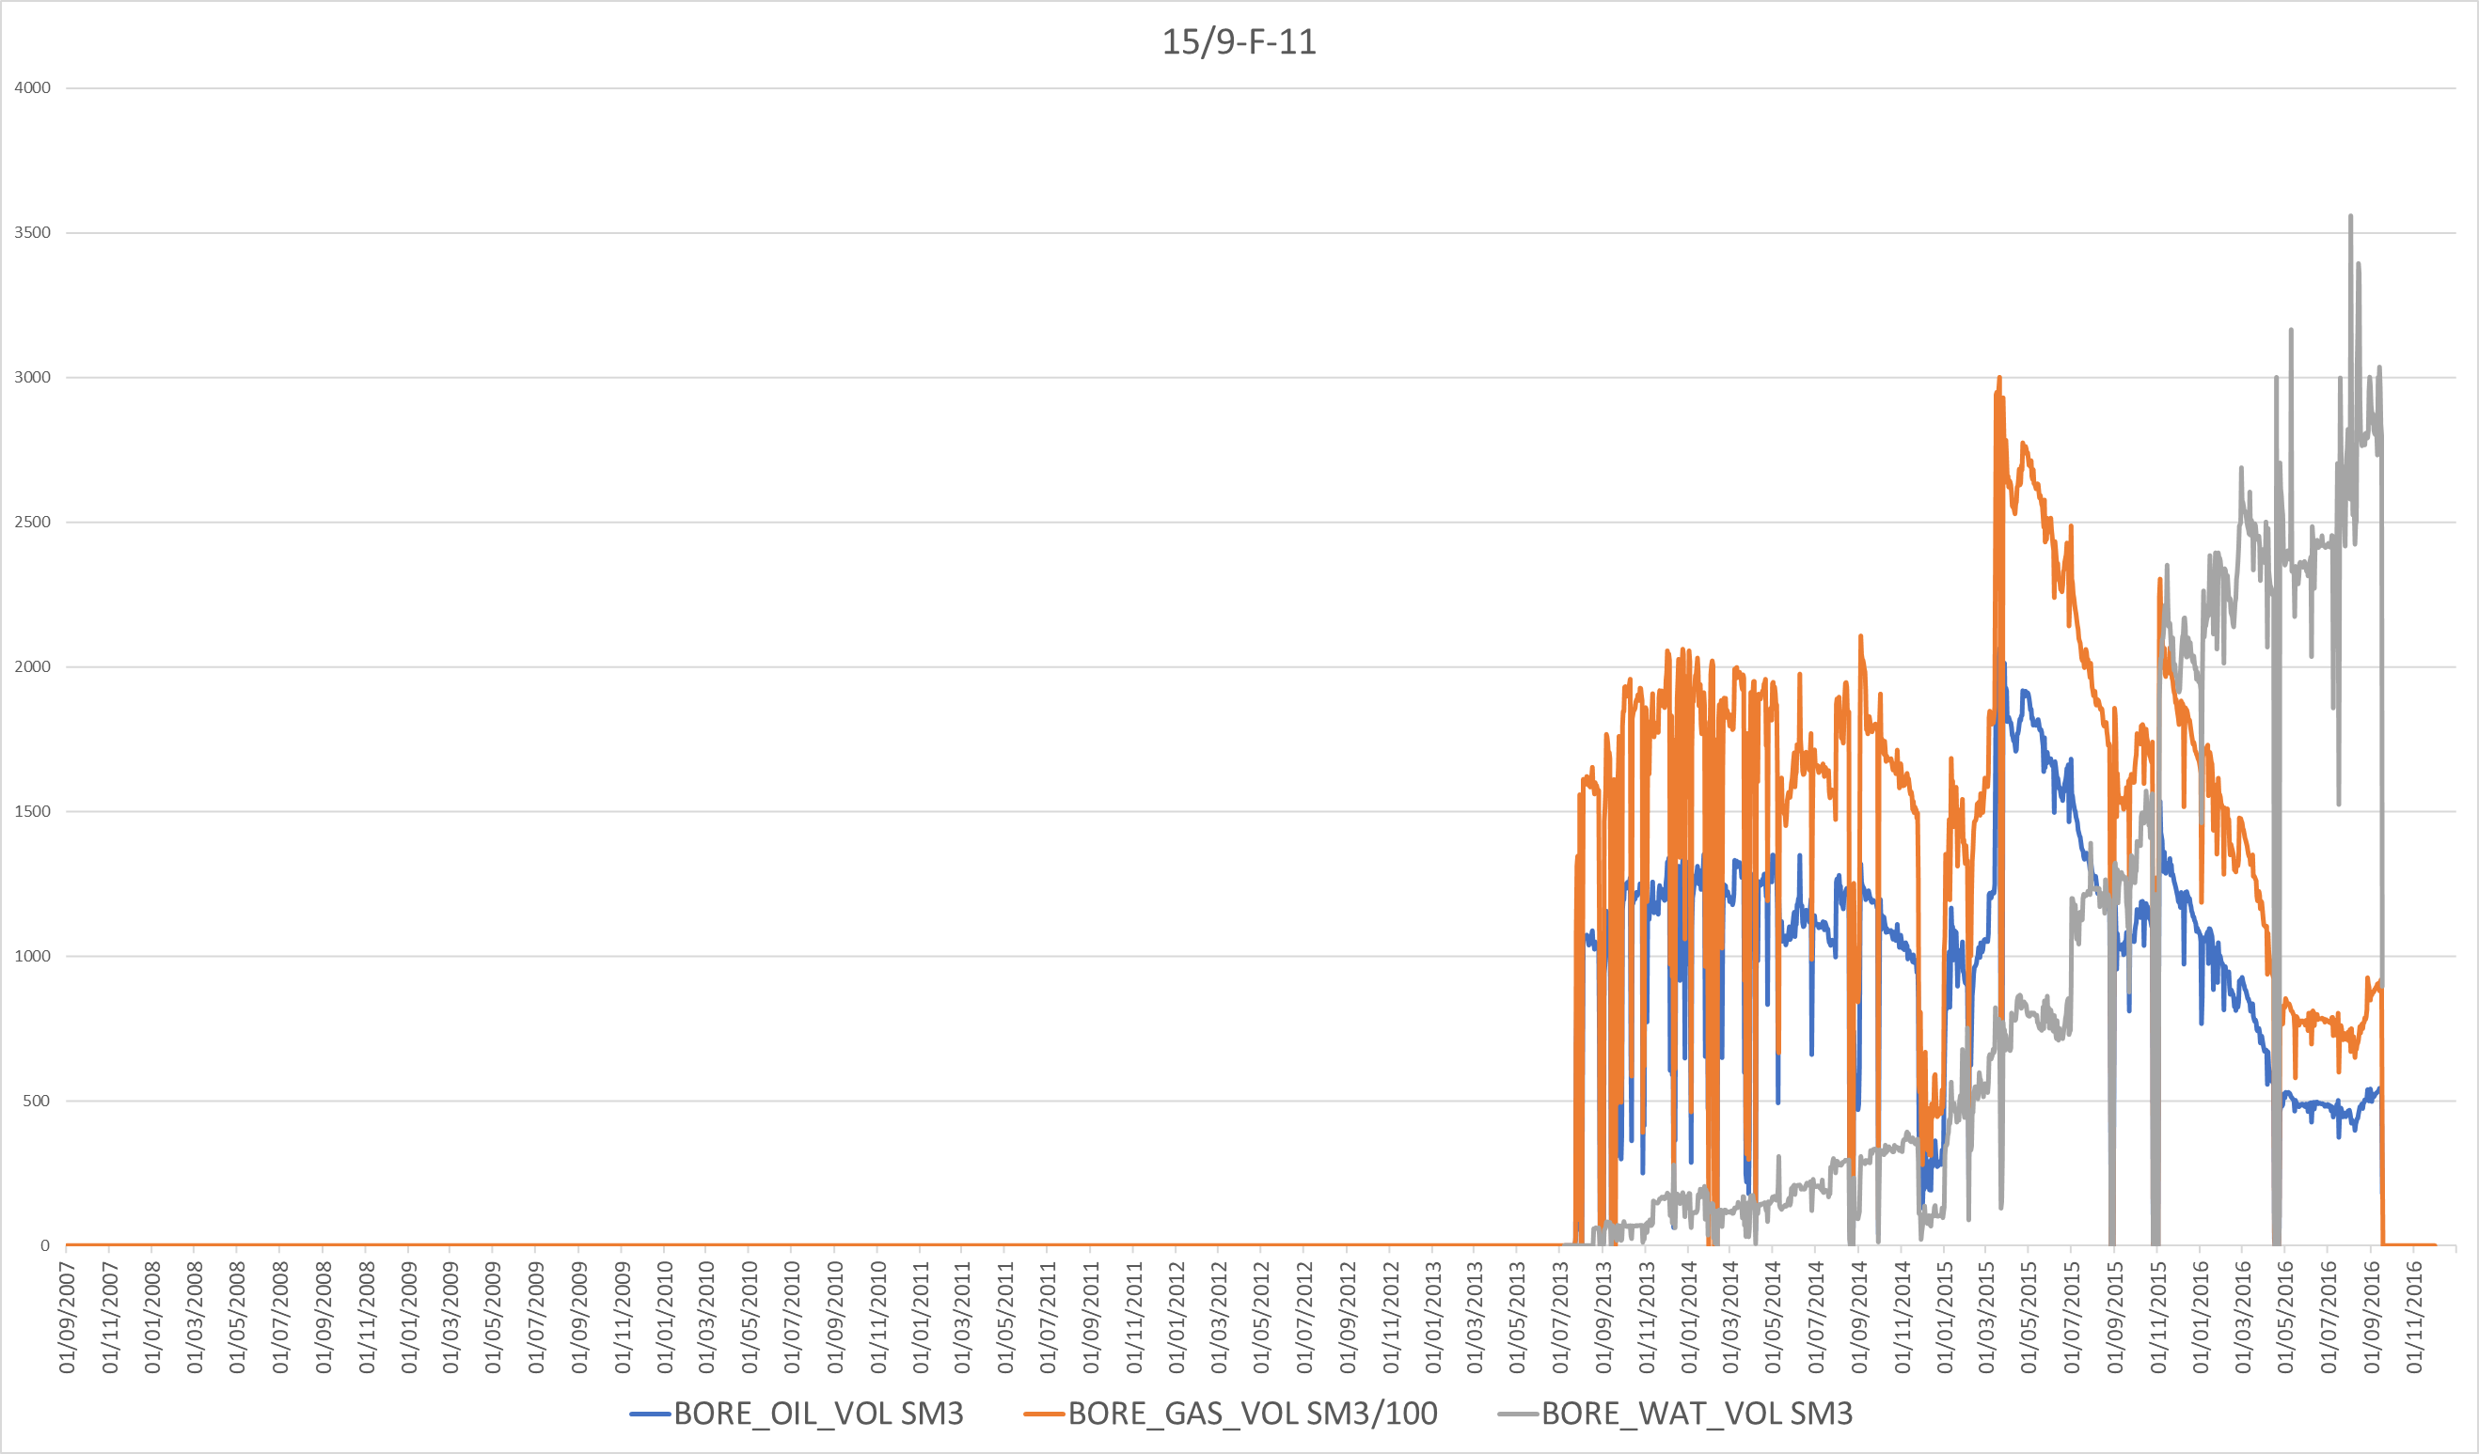
15/9-F-11
Skin factor improvement?
Drop in production coincides
with drop in injectionin the F4 well
Rise in water cut again
Zonal isolation
+ new intervals?

Slide 8
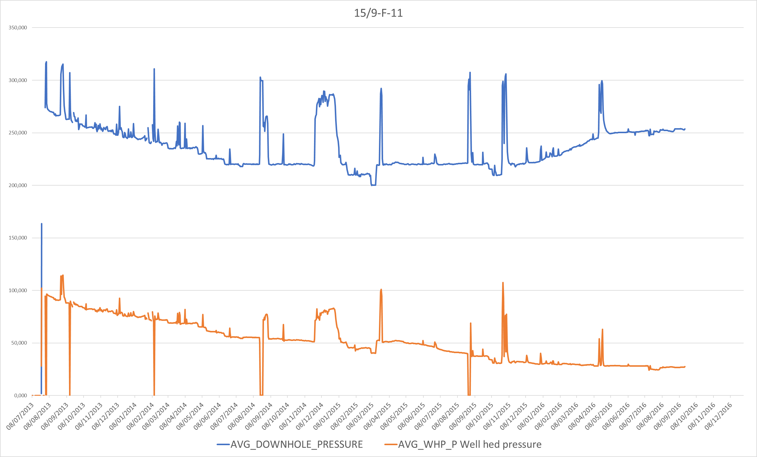
15/9-F-11
Pres = 300
Well | 15/9-F-11
Date | 13/11/2014
Pres | 300
Pbhfp | 220,026
delta P | 79,974
Oil | 1 001
Water | 362
Liquid | 1 363
PI | 17,04

Slide 9
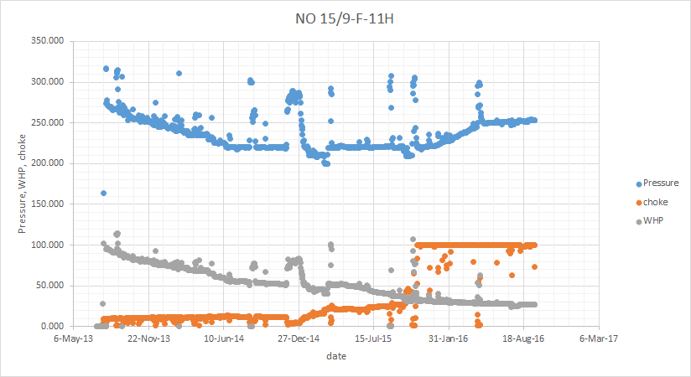
Gradual rise of downhole pressure is not associated to the increase in choke size, as it would cause decrease in Downhole pressure. It would also cause an increase in Well head pressure, which is not observed.

Slide 10
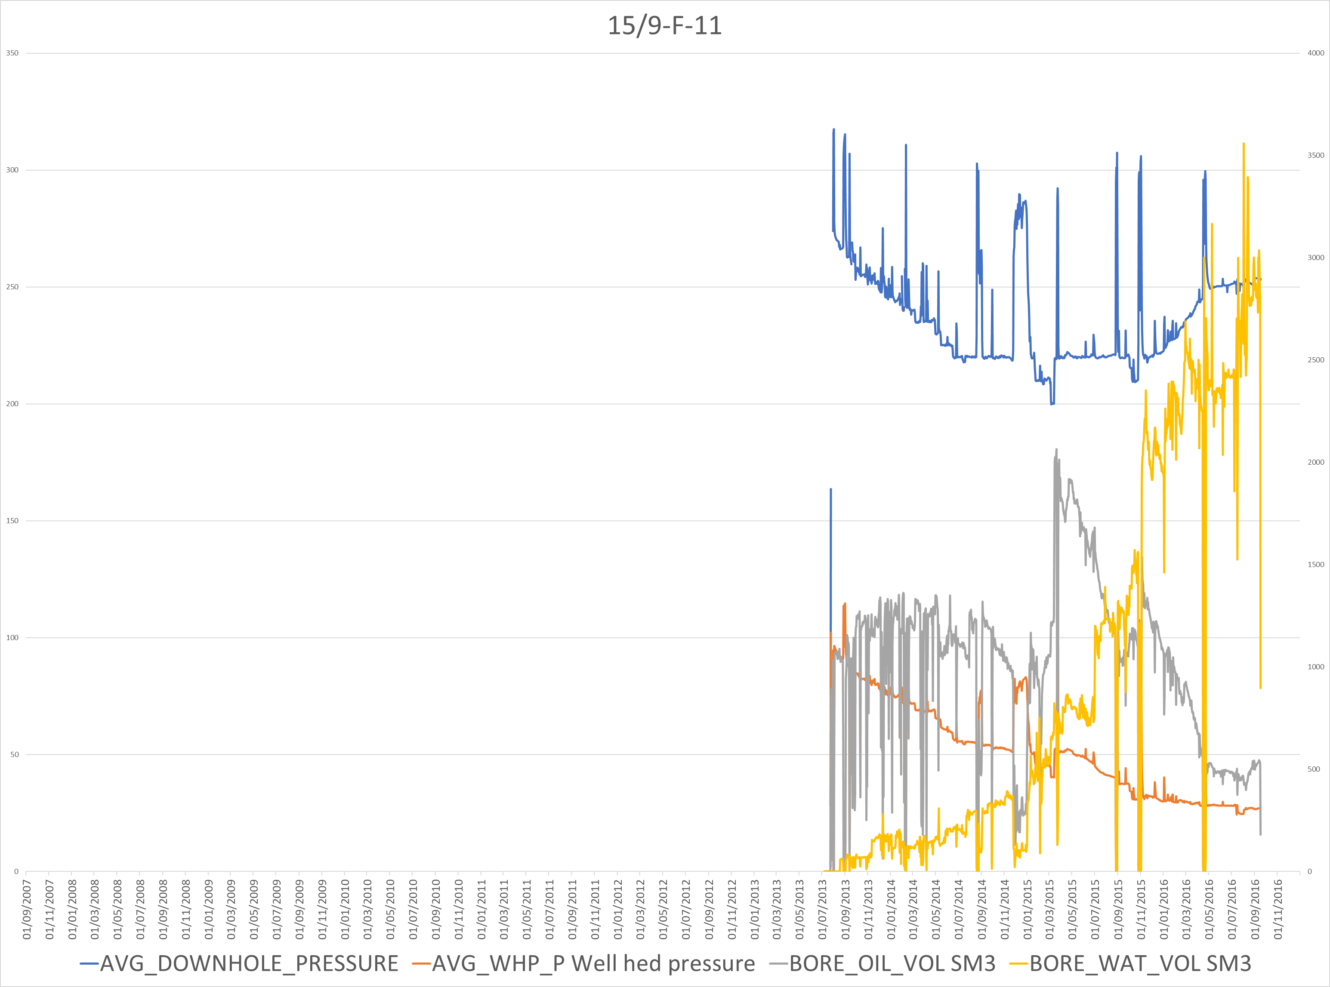
15/9-F-11

Slide 11
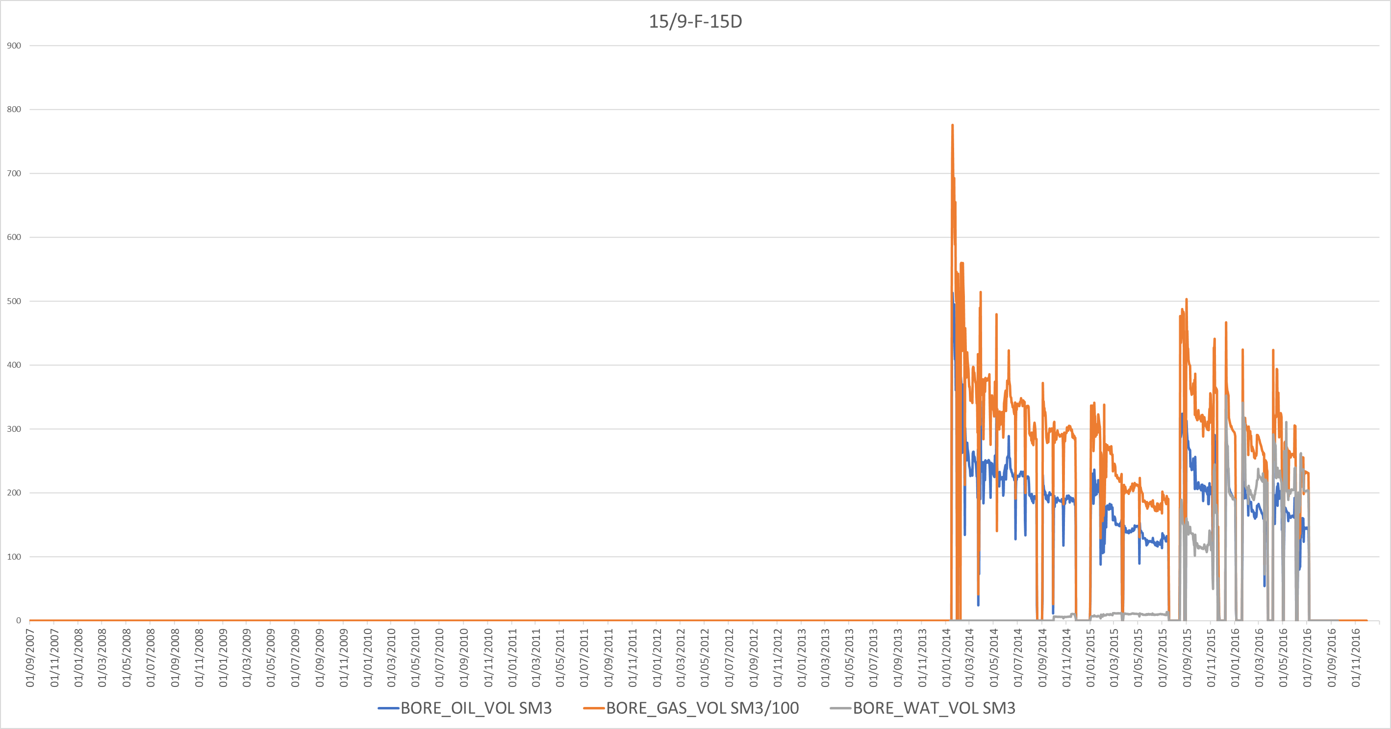
15/9-F-15D
Water cut rises suddenly:
Opening of new perforations?

Slide 12
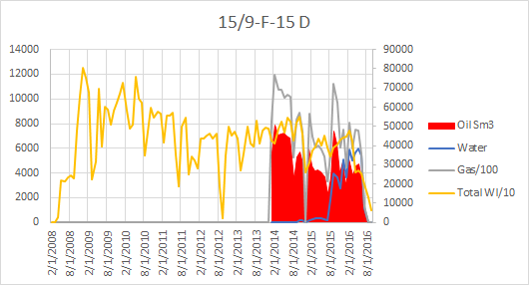

Slide 13
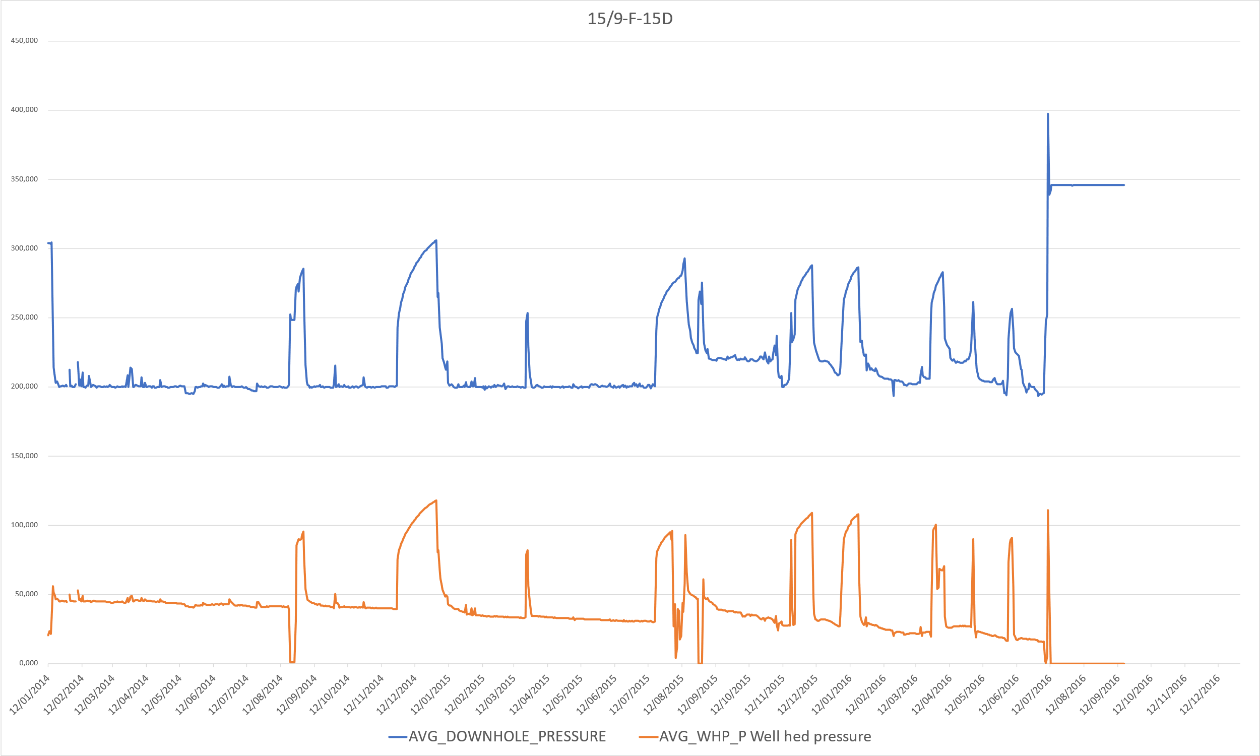
15/9-F-15D
Pres = 340
Pres = 310
Pres = 290
Pres = 310
Delta Pres = 187,79

Slide 14
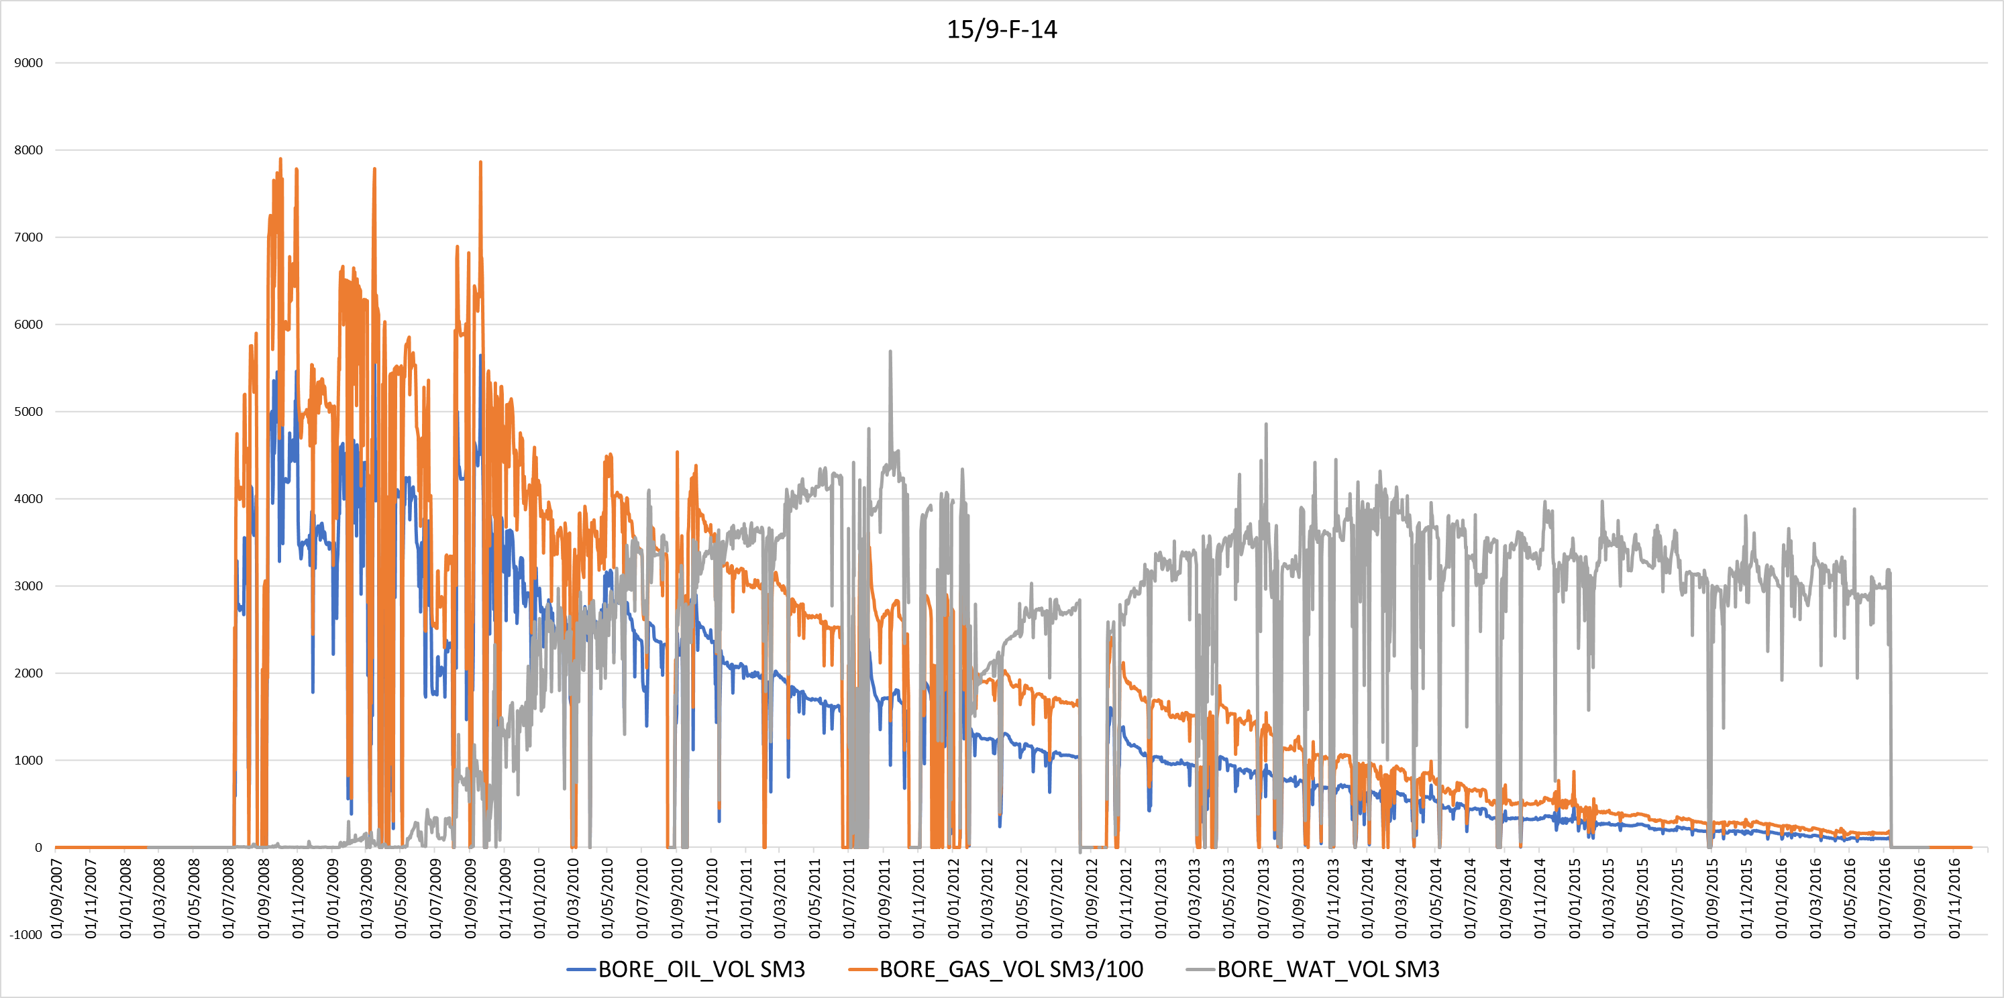
15/9-F-14
Increase in production tied to start of second injection
Could be related to choke opening too
Flush production effect

Slide 15
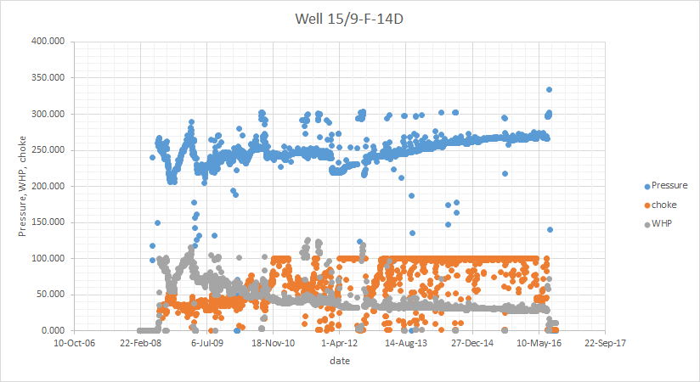
Gradual rise of downhole pressure is associated to the rise of borehole fluid density. Increase in choke size would have inverse effect

Slide 16
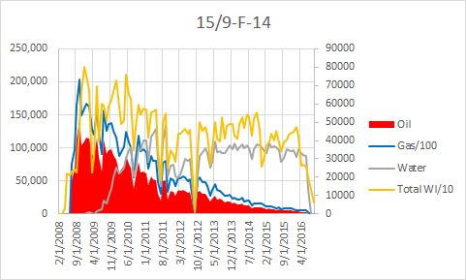

Slide 17
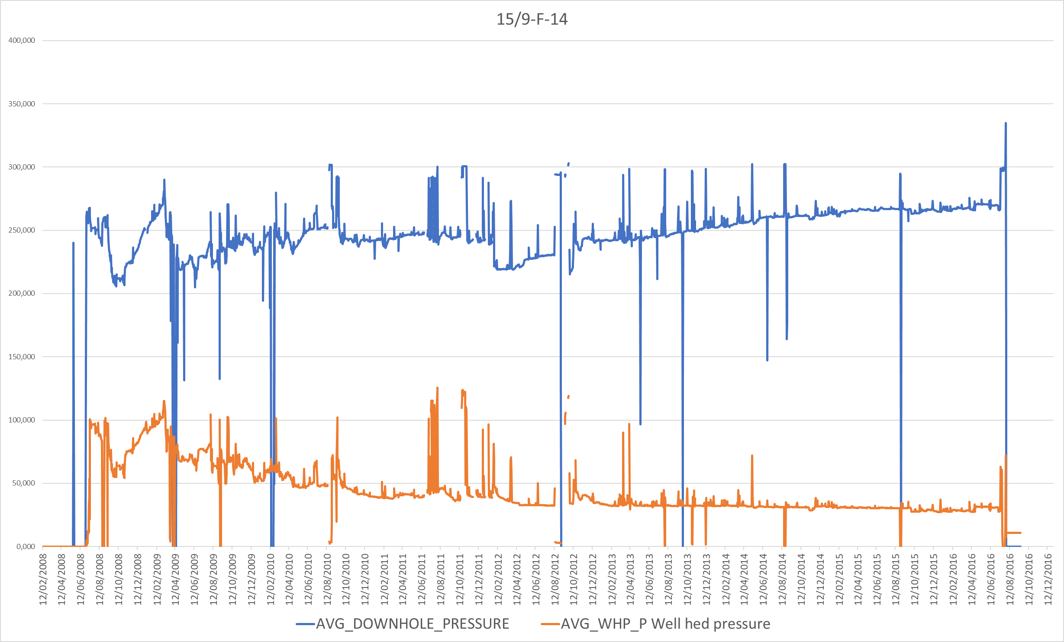
15/9-F-14
Why is there an Upward trend of BHFP?
→Stable reservoir pressure but Water cut
increasing so bigger BHFP due to rising borehole fluid density

Slide 18
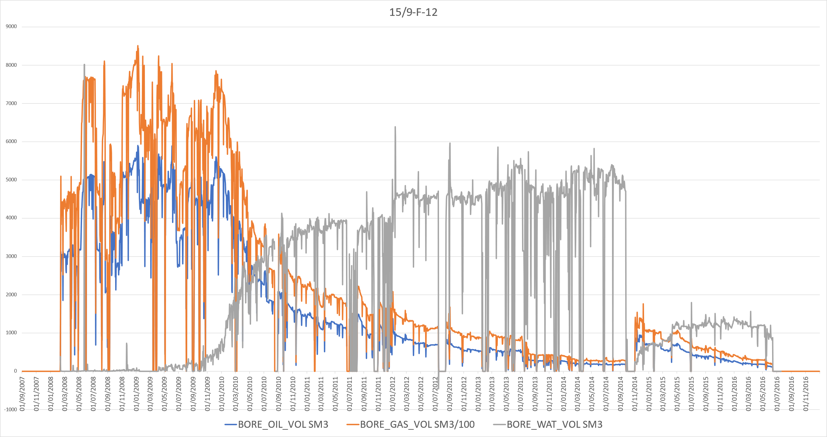
15/9-F-12
Increase in production shortly after start of first injection
Increase in production after incremental start of second injection
Maintenance / workover?
Zonal isolation?

Slide 19
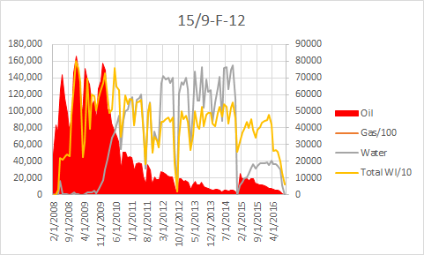

Slide 20
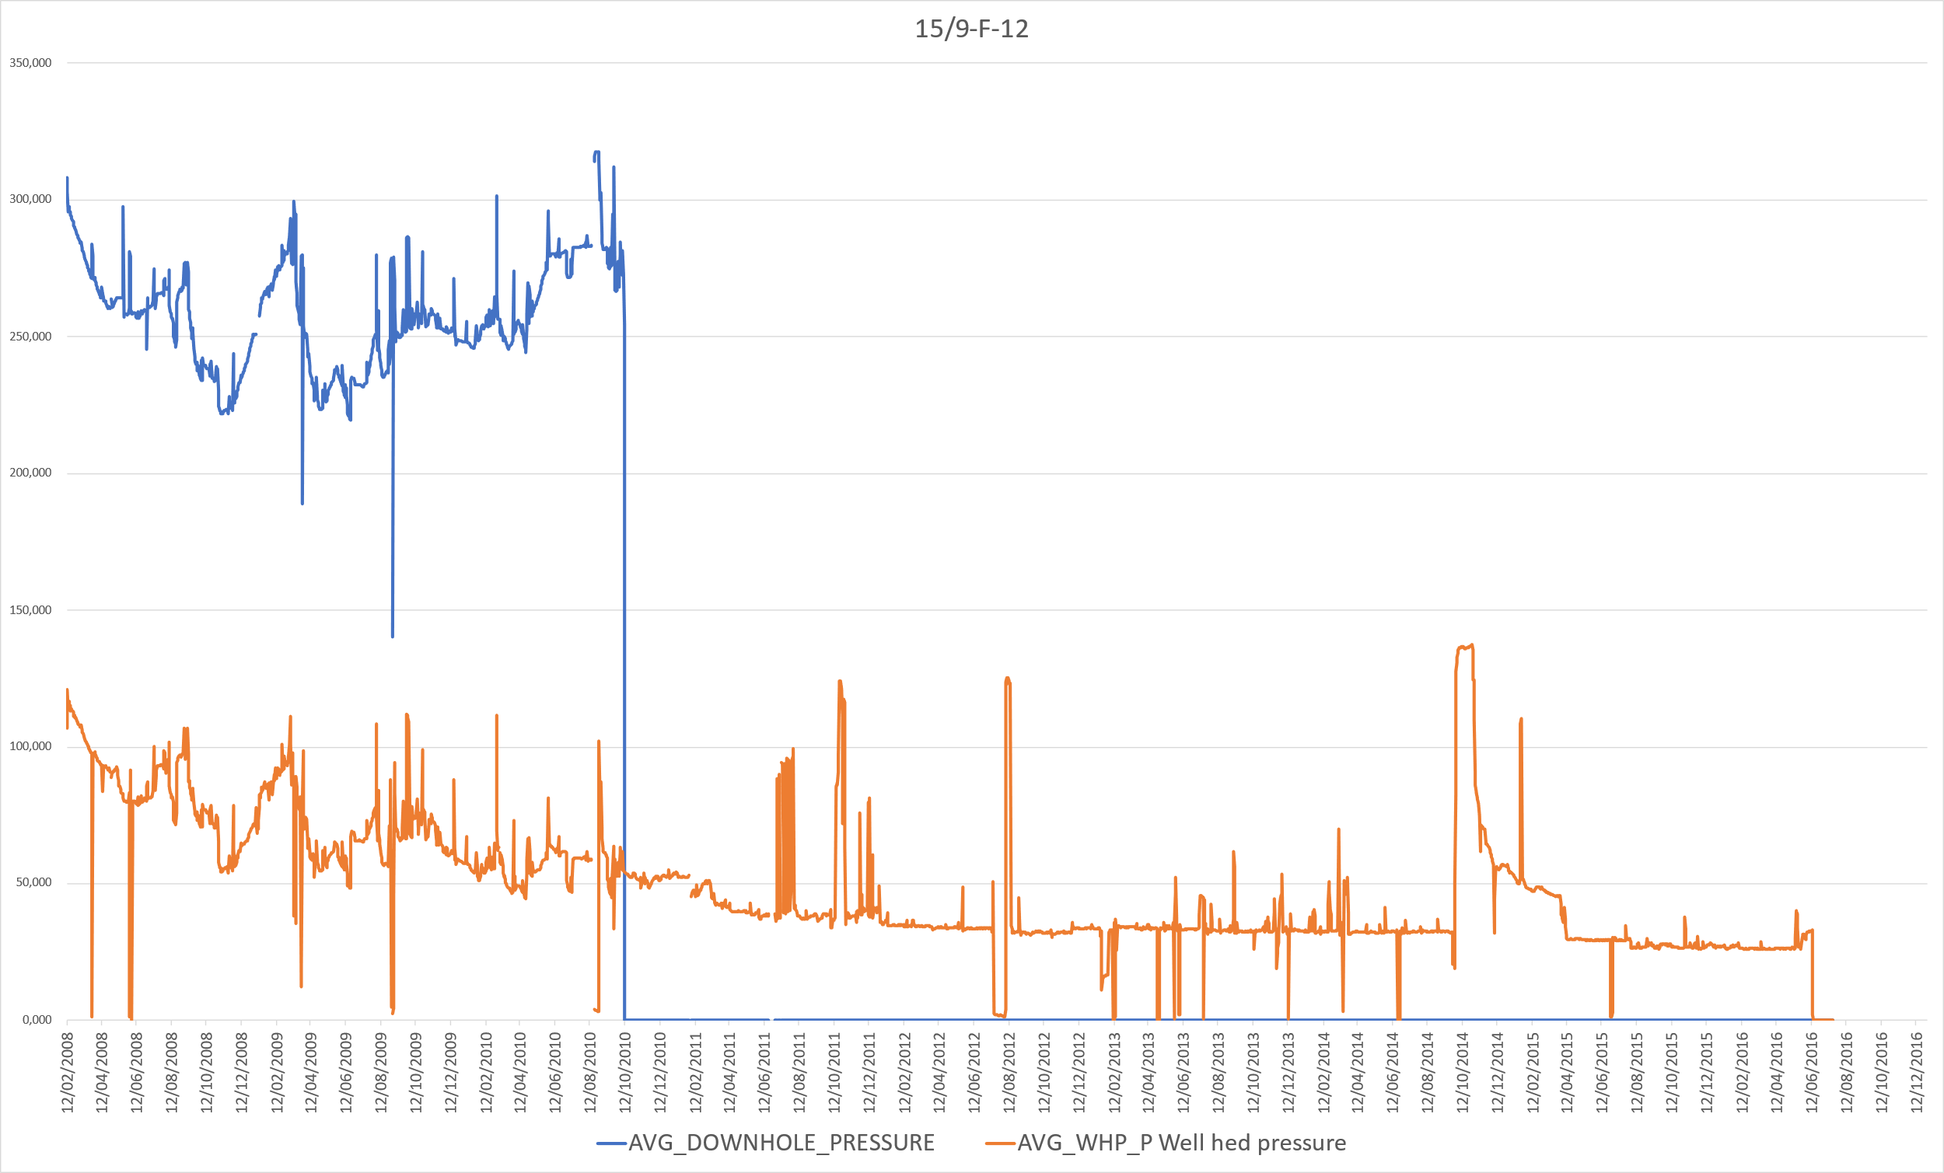
15/9-F-12
Pressure increase is tied to first injection incremental start

Slide 21
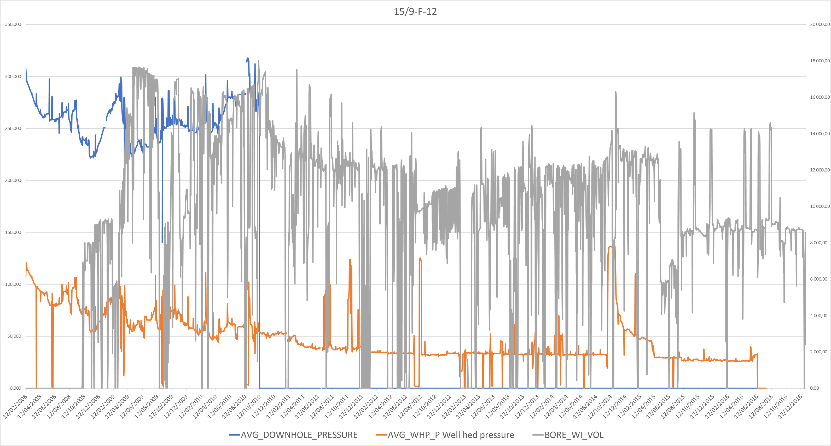
Pressure increase is tied to second injection start
Brutal pressure decrease is tied to second injection decrease
Gradual pressure increase is tied to second injection start

Slide 22
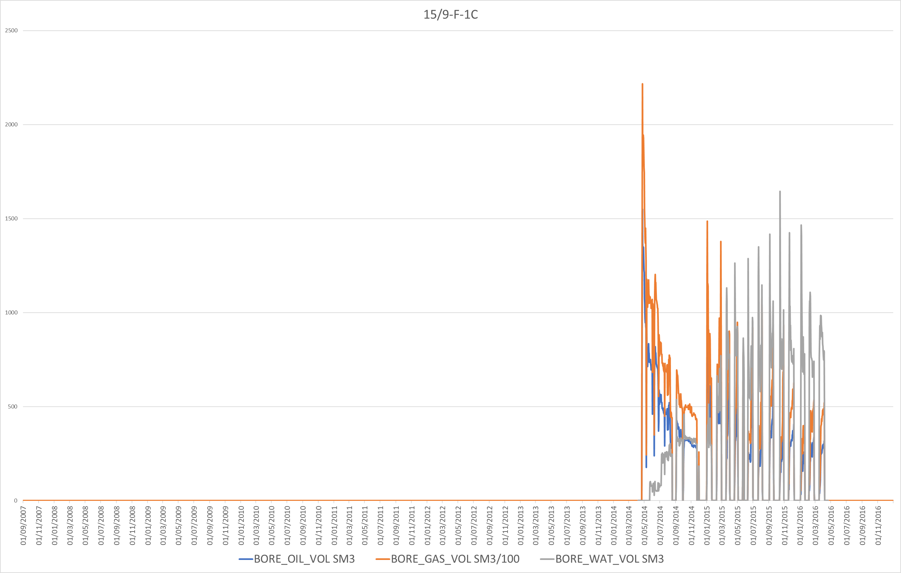
15/9-F-1C
Well is opened and closed
intermittently, high watercut.
Periods of closing needed to build up pressure near the well bore?
Originally high production
declines rapidly

Slide 23
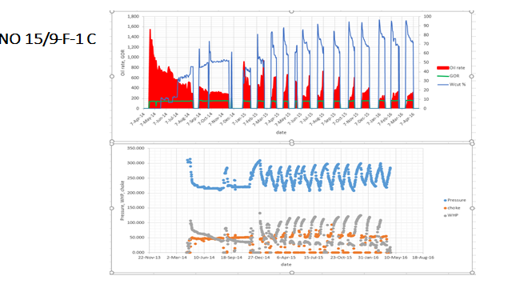
The intermittent opening of the well is confirmed was from the choke size.

Slide 24
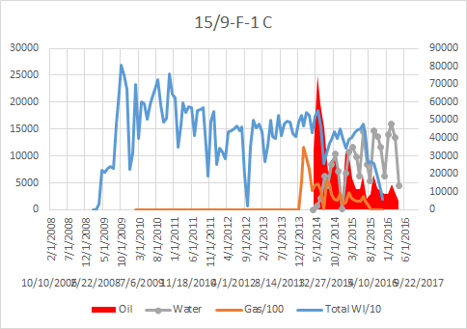

Slide 25
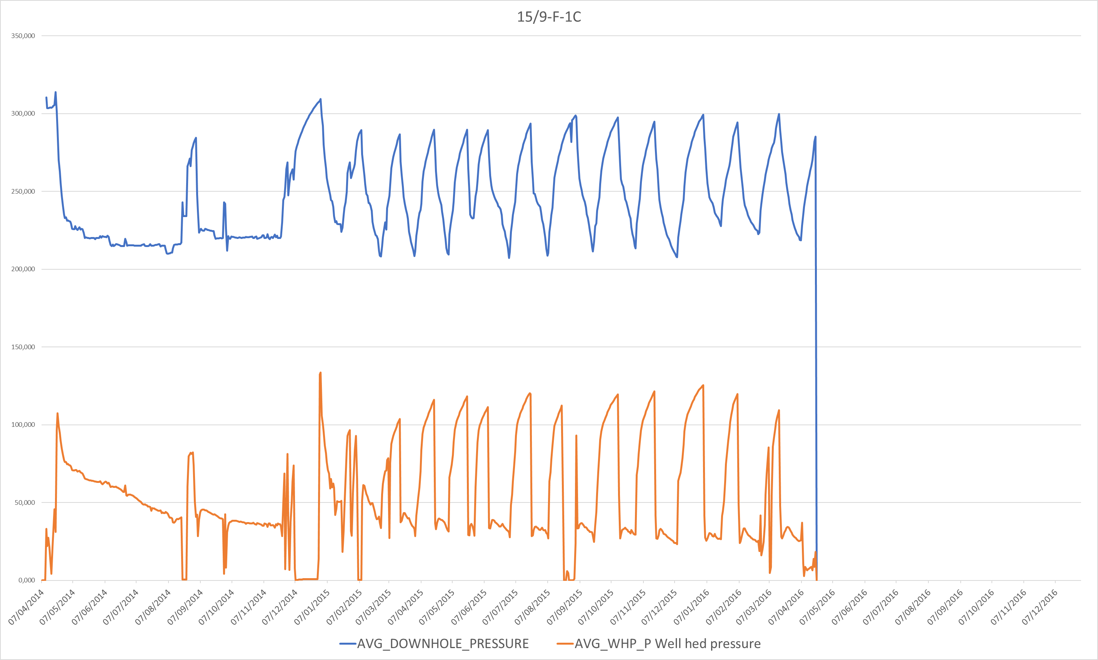
15/9-F-1C
Pres = 350
Well | 15/9-F-1C
Date | 20/11/2014
Pres | 350
Pbhfp | 222,000
delta P | 128,000
Oil | 285
Water | 303
Liquid | 588
PI | 4,59

Slide 26
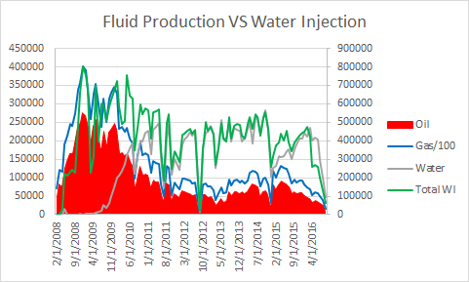
Injected water trend follows production trend perfectly
Produce more fluids than they inject. Underlying acquifer helping?

Slide 27
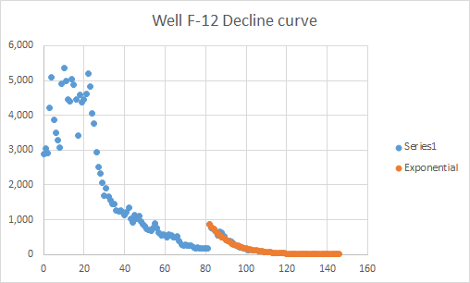

Slide 28
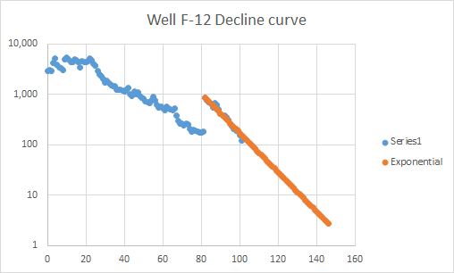
Flow rate VS Time
Curve becomes linear: confirms exponential nature of decline

Slide 29
Sources
Arcgis.com website: https://www.arcgis.com/apps/Cascade/index.html?appid=c69d228730e2460da9c67cde26121020

